Slide 1
SANITY CHECK
Sanity check is a basic test to calculate whether the application’s functionality is available or not
Sanity check is the activity we are performing after every maintenances
Need to check all url's are working or not
Need to check the data accessing or not

Slide 2
Which are the applications and databases we are doing in regular weekly maintenances?
I360 application
Vfton application
Mark application
Dataiku application
Rds database

Slide 3
Checking url's are working or not
After completion of maintenance activities, we need to cross check url's are opening or not.
This are the url's we are need to check:
PRODUCTION:
https://i360history.corp.wabtec.com/i360history
http://vfton.corp.wabtec.com/vfton2/#/output
https://mark.corp.wabtec.com/constant-rate
http://designer.dataiku.corp.wabtec.com/login

Slide 4
DEVELOPMENT URL'S
https://dev-i360history.corp.wabtec.com/i360history/#/Content/Workorder
https://dev-vfton.corp.wabtec.com/vfton2/#/Output
https://dev-mark.corp.wabtec.com/my-analyses
http://dev-designer.dataiku.corp.wabtec.com/login

Slide 5
How to check data accessing or not?
Open the url's and need to check all tabs in the application is working or not.
Example
Consider we are checking sanity of I360 application
First open that url -- https://i360history.corp.wabtec.com/i360history
Click on Road failures tab and choose Bnsf -- 7575
After clicking enter data is visible means data is accessing.
Click on each tabs in the application to verify data is accessing or not.

Slide 6
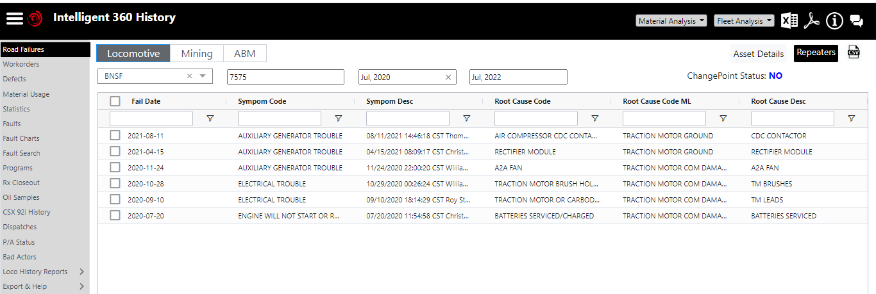

Slide 7
Every Week we are doing regular maintenances Activities and we need to verify url's are working and data is accessing. If url's are not working, it will be fixed to function normally.
Thank You

